Slide 1

Don't put your messages in a bottle
Implement messaging patterns

Slide 2




Introduction
Olena Borzenko
Xpirit
Celestial Programmer / CDO (Chief Drinking Officer)
Azure MVP
@borzenko_lena
Eldert Grootenboer
Microsoft
Program Manager Azure Service Bus
@egrootenboer
Notes:
O & E

Slide 3

Speaker Bio
Eldert Grootenboer
He/Him
Program Manager - Azure Service Bus
@egrootenboer
egrootenboer@microsoft.com

Slide 4










Azure Messaging Platform
AMQP
JMS
Connect apps on an enterprise message queueing and pub-sub platform using open protocols including JMS 2.0​
Message Queue Broker
Azure Service Bus
Elastic Pub-Sub Broker​
Publish and subscribe MQTT messages and HTTP push and pull for delivery of discrete events​
>75% of S500 customers use 2 or more of our messaging services
Azure Event Grid
Event Stream Engine​
Cloud-scale, low latency streaming platform supporting Apache Kafka and AMQP clients and services​
Azure Event Hubs
Event Stream Processor
Real-time stream processing and analytics engine with rich development tools and low/no-code editor experiences​
Azure Stream Analytics

Slide 5

Messaging Patterns

Slide 6
What are messaging patterns
Recurring scenarios
Abstract
Reusable
Notes:
Patterns are accepted solutions to recurring problems within a given context.
They are abstract enough to apply to most integration technologies, but specific enough to provide hands-on guidance to designers and architects.
Patterns also provide a vocabulary for developers to efficiently describe their solution.
2

Slide 7
Why use messaging patterns
Don’t reinvent the wheel
Use experts’ experience
Standards
Notes:
3

Slide 8

Competing Consumers
https://docs.microsoft.com/en-us/azure/architecture/patterns/competing-consumers

Slide 9
Competing Consumers

Slide 10

Competing Consumers

Slide 11
Competing Consumers
Notes:
->

Slide 12
Competing Consumers

Slide 13
Competing Consumers

Slide 14
Competing Consumers

Slide 15
Competing Consumers
Notes:
->

Slide 16
Competing Consumers

Slide 17
Competing Consumers
Notes:
->

Slide 18
Competing Consumers

Slide 19
Competing Consumers
Notes:
->

Slide 20
Competing Consumers
Notes:
->

Slide 21
Competing Consumers
Notes:
->

Slide 22
Competing Consumers
Notes:
->

Slide 23
Competing Consumers
Notes:
->

Slide 24
Competing Consumers
Notes:
->

Slide 25
Competing Consumers
Notes:
->

Slide 26
Competing Consumers
Notes:
->

Slide 27
Competing Consumers
Notes:
->

Slide 28
Competing Consumers

Slide 29
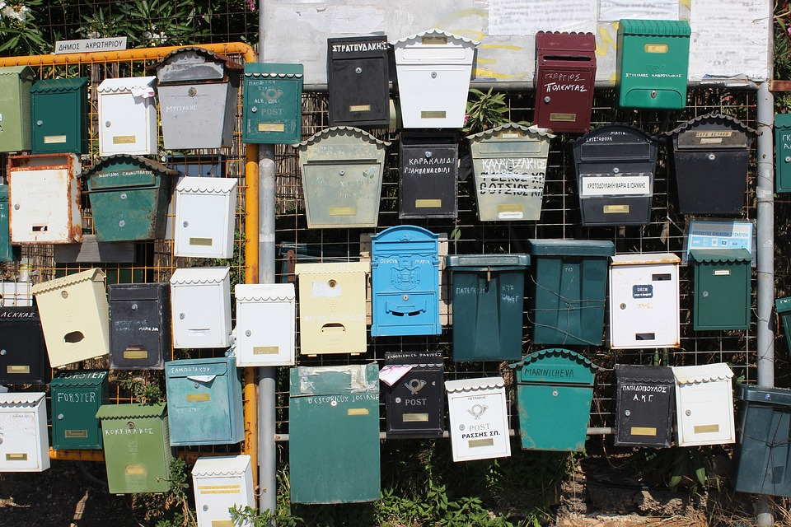
Publisher-Subscriber
https://docs.microsoft.com/en-us/azure/architecture/patterns/publisher-subscriber

Slide 30
Publisher-Subscriber

Slide 31
Publisher-Subscriber

Slide 32
Publisher-Subscriber
Notes:
->

Slide 33
Publisher-Subscriber
Notes:
->

Slide 34
Publisher-Subscriber

Slide 35
Publisher-Subscriber
Notes:
->

Slide 36
Publisher-Subscriber
Notes:
->

Slide 37
Publisher-Subscriber
Notes:
->

Slide 38
Publisher-Subscriber

Slide 39
Publisher-Subscriber
Notes:
->

Slide 40
Publisher-Subscriber
Notes:
->

Slide 41
Publisher-Subscriber

Slide 42
Publisher-Subscriber
Notes:
->

Slide 43
Publisher-Subscriber
Notes:
->

Slide 44
Publisher-Subscriber
Notes:
->

Slide 45
Publisher-Subscriber
Notes:
->

Slide 46
Publisher-Subscriber
Notes:
->

Slide 47
Publisher-Subscriber
Notes:
->

Slide 48
Publisher-Subscriber
Notes:
->

Slide 49
Publisher-Subscriber
Notes:
->

Slide 50
Publisher-Subscriber
Notes:
->

Slide 51
Publisher-Subscriber
Notes:
->

Slide 52
Publisher-Subscriber
Notes:
->

Slide 53
Publisher-Subscriber

Slide 54

Message Filter
https://www.enterpriseintegrationpatterns.com/Filter.html

Slide 55
Message Filter

Slide 56
Message Filter
A
B
A

Slide 57
Message Filter
A
B
A

Slide 58
Message Filter
A
A
B
Notes:
->

Slide 59
Message Filter
A
A
B

Slide 60
Message Filter
A
A
B
Notes:
->

Slide 61
Message Filter
A
A
B
Notes:
->

Slide 62
Message Filter
A
A
B
Notes:
->

Slide 63
Message Filter
A
A
B

Slide 64
Message Filter
A
A
B
Notes:
->

Slide 65
Message Filter
A
B
Notes:
->

Slide 66
Message Filter
A
B
Notes:
->

Slide 67
Message Filter
A
Notes:
->

Slide 68
Message Filter

Slide 69
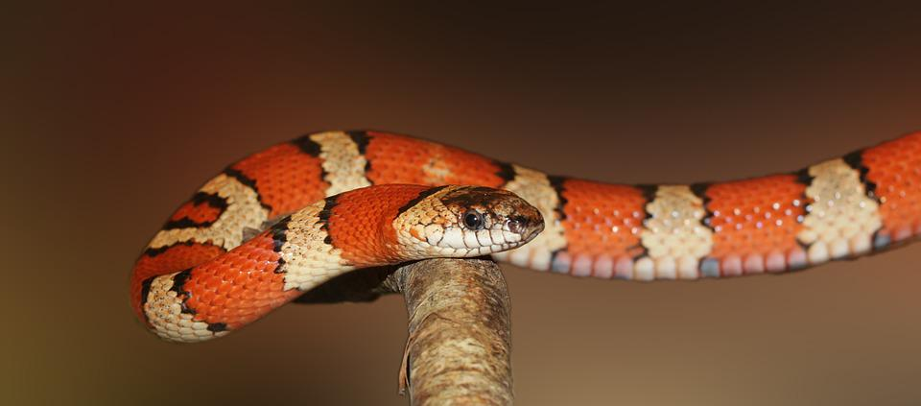
Message Poisoning
https://en.wikipedia.org/wiki/Poison_message

Slide 70
Message Poisoning

Slide 71
Message Poisoning

Slide 72
Message Poisoning

Slide 73
Message Poisoning
Notes:
->

Slide 74
Message Poisoning

Slide 75
Message Poisoning
Notes:
->

Slide 76
Message Poisoning

Slide 77
Message Poisoning
Notes:
->

Slide 78
Message Poisoning
Notes:
->

Slide 79
Message Poisoning

Slide 80
Message Poisoning

Slide 81
Message Poisoning
Notes:
->

Slide 82
Message Poisoning
Notes:
->

Slide 83
Message Poisoning

Slide 84
Message Poisoning
Notes:
->

Slide 85
Message Poisoning

Slide 86
Message Poisoning
Notes:
->

Slide 87
Message Poisoning
Notes:
->

Slide 88
Message Poisoning

Slide 89

Idempotent Receiver
https://www.enterpriseintegrationpatterns.com/IdempotentReceiver.html

Slide 90
Idempotent Receiver
1
2
3
4

Slide 91
Idempotent Receiver
4
3
2
1

Slide 92
Idempotent Receiver
1
4
3
2
Notes:
->

Slide 93
Idempotent Receiver
1
4
3
2
Notes:
->

Slide 94
Idempotent Receiver
1
4
3
2
Notes:
->

Slide 95
Idempotent Receiver
1
4
3
2

Slide 96
Idempotent Receiver
1
5
4
3
6
2
Notes:
->

Slide 97
Idempotent Receiver
1
6
5
4
3
2

Slide 98
Idempotent Receiver
6
5
4
3
2
Notes:
->

Slide 99
Idempotent Receiver
3
6
5
4
2
Notes:
->

Slide 100
Idempotent Receiver
3
6
5
4
2
Notes:
->

Slide 101
Idempotent Receiver
1
3
6
5
4
2

Slide 102
Idempotent Receiver
3
1
6
5
4
2

Slide 103
Idempotent Receiver
3
1
6
5
4
2

Slide 104
Idempotent Receiver
3
6
5
4
2

Slide 105
Idempotent Receiver
3
6
5
4
Notes:
->

Slide 106
Idempotent Receiver
3
6
5
4
Notes:
->

Slide 107
Idempotent Receiver
3
6
5
4
Notes:
->

Slide 108
Idempotent Receiver
5
6
4
Notes:
->

Slide 109
Idempotent Receiver
5
6
4
Notes:
->

Slide 110
Idempotent Receiver
5
6
Notes:
->

Slide 111
Idempotent Receiver
5
6
Notes:
->

Slide 112
Idempotent Receiver
6
Notes:
->

Slide 113
Idempotent Receiver

Slide 114

Message Scheduling
https://docs.microsoft.com/en-us/azure/service-bus-messaging/message-sequencing#scheduled-messages

Slide 115
Message Scheduling

Slide 116
Message Scheduling
Notes:
->

Slide 117
Message Scheduling
Notes:
->

Slide 118
Message Scheduling

Slide 119
Message Scheduling
5s

Slide 120
Message Scheduling
5s
Notes:
->

Slide 121
Message Scheduling
5s

Slide 122
Message Scheduling
5s
Notes:
->

Slide 123
Message Scheduling
5s
Notes:
->

Slide 124
Message Scheduling
5s
Notes:
->

Slide 125
Message Scheduling
5s

Slide 126
Message Scheduling
Notes:
->

Slide 127
Message Scheduling

Slide 128
Message Scheduling
Notes:
->

Slide 129
Message Scheduling
Notes:
->

Slide 130
Message Scheduling
Notes:
->

Slide 131
Message Scheduling
Notes:
->

Slide 132
Message Scheduling
Notes:
->

Slide 133
Message Scheduling

Slide 134

Transactional Queues
https://docs.microsoft.com/en-us/azure/service-bus-messaging/service-bus-transactions

Slide 135
Transactional Queues

Slide 136
Transactional Queues

Slide 137
Transactional Queues

Slide 138
Transactional Queues

Slide 139
Transactional Queues

Slide 140
Transactional Queues
Notes:
->

Slide 141
Transactional Queues

Slide 142
Transactional Queues
Notes:
->

Slide 143
Transactional Queues
Notes:
->

Slide 144
Transactional Queues

Slide 145
Transactional Queues
Notes:
->

Slide 146
Transactional Queues
Notes:
->

Slide 147
Transactional Queues
Notes:
->

Slide 148
Transactional Queues
Notes:
->

Slide 149
Transactional Queues
Notes:
->

Slide 150
Transactional Queues

Slide 151

Asynchronous Request-Reply
https://docs.microsoft.com/en-us/azure/architecture/patterns/async-request-reply

Slide 152
Asynchronous Request-Reply

Slide 153
Asynchronous Request-Reply

Slide 154
Asynchronous Request-Reply
Notes:
->

Slide 155
Asynchronous Request-Reply

Slide 156
Asynchronous Request-Reply

Slide 157
Asynchronous Request-Reply

Slide 158
Asynchronous Request-Reply

Slide 159
Asynchronous Request-Reply
Notes:
->

Slide 160
Asynchronous Request-Reply
Notes:
->

Slide 161
Asynchronous Request-Reply

Slide 162
Asynchronous Request-Reply
Notes:
->

Slide 163
Asynchronous Request-Reply

Slide 164
Asynchronous Request-Reply

Slide 165

Sequential Convoy
https://docs.microsoft.com/en-us/azure/architecture/patterns/sequential-convoy

Slide 166
Sequential Convoy

Slide 167
Sequential Convoy
A
C
B
C

Slide 168
Sequential Convoy
A
B
C
C

Slide 169
Sequential Convoy
A
A
B
B
C
C
A
Notes:
->

Slide 170
Sequential Convoy
A
A
A
B
B
C
C

Slide 171
Sequential Convoy
A
A
A
B
C
C
B
Notes:
->

Slide 172
Sequential Convoy
A
A
A
B
C
C
B

Slide 173
Sequential Convoy
A
A
A
B
C
C

Slide 174
Sequential Convoy
A
A
A
C
C
B

Slide 175
Sequential Convoy
A
A
C
C
B
Notes:
->

Slide 176
Sequential Convoy
A
A
C
C
B
Notes:
->

Slide 177
Sequential Convoy
A
A
C
C
B
Notes:
->

Slide 178
Sequential Convoy
A
A
C
C

Slide 179
Sequential Convoy
A
A
C
C
Notes:
->

Slide 180
Sequential Convoy
A
A
C
C
Notes:
->

Slide 181
Sequential Convoy
A
C
C
Notes:
->

Slide 182
Sequential Convoy
A
C
C
Notes:
->

Slide 183
Sequential Convoy
A
C
Notes:
->

Slide 184
Sequential Convoy
A
C
Notes:
->

Slide 185
Sequential Convoy
A
Notes:
->

Slide 186
Sequential Convoy

Slide 187
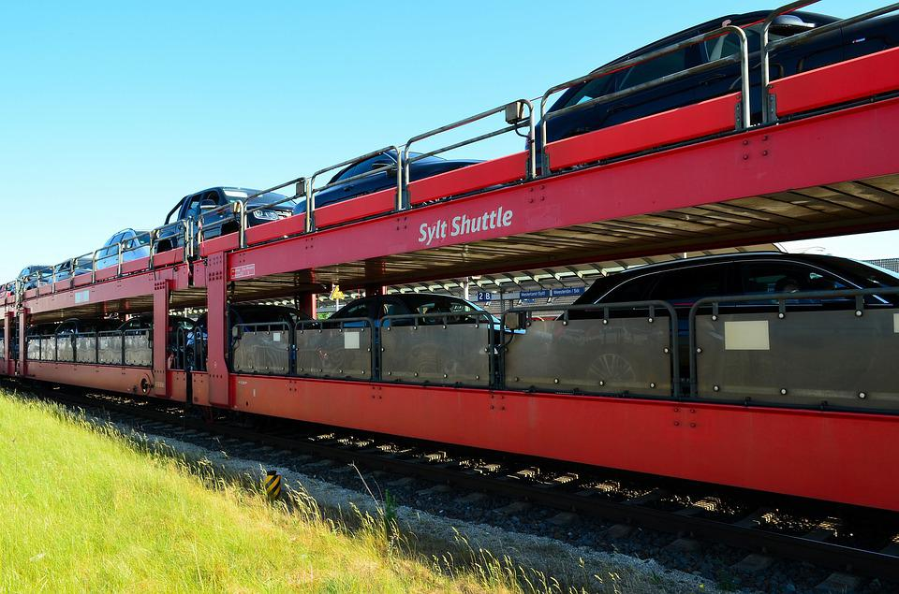
Claim Check
https://docs.microsoft.com/en-us/azure/architecture/patterns/claim-check

Slide 188


Claim Check

Slide 189
Claim Check

Slide 190
Claim Check

Slide 191

Claim Check

Slide 192
Claim Check
Notes:
->

Slide 193
Claim Check

Slide 194
Claim Check

Slide 195
Claim Check
Notes:
->

Slide 196
Claim Check

Slide 197
Claim Check

Slide 198
Claim Check
Notes:
->

Slide 199
Claim Check

Slide 200
Claim Check

Slide 201
Claim Check

Slide 202
Claim Check

Slide 203

Exactly Once Processing
https://www.cloudcomputingpatterns.org/exactly_once_delivery/

Slide 204

Exactly Once Processing

Slide 205
Exactly Once Processing
1
Notes:
->

Slide 206
Exactly Once Processing
1
Notes:
->

Slide 207
Exactly Once Processing
2
1
Notes:
->

Slide 208
Exactly Once Processing
2
1
Notes:
->

Slide 209
Exactly Once Processing
2
1
Notes:
->

Slide 210
Exactly Once Processing
2
1

Slide 211
Exactly Once Processing
2
1
Notes:
->

Slide 212
Exactly Once Processing
3
2
1
Notes:
->

Slide 213
Exactly Once Processing
3
2
1
Notes:
->

Slide 214
Exactly Once Processing
3
2
Notes:
->

Slide 215
Exactly Once Processing
3
2
Notes:
->

Slide 216
Exactly Once Processing
3
2
Notes:
->

Slide 217
Exactly Once Processing
3
2
Notes:
->

Slide 218
Exactly Once Processing
1
3
2

Slide 219
Exactly Once Processing
1
3
2
Notes:
->

Slide 220
Exactly Once Processing
1
3
2

Slide 221
Exactly Once Processing
3
2

Slide 222
Exactly Once Processing
3
2
2

Slide 223
Exactly Once Processing
3
2
Notes:
->

Slide 224
Exactly Once Processing
3
2
Notes:
->

Slide 225
Exactly Once Processing
3
2

Slide 226
Exactly Once Processing
3
Notes:
->

Slide 227
Exactly Once Processing
3
Notes:
->

Slide 228
Exactly Once Processing
3
Notes:
->

Slide 229
Exactly Once Processing
3
Notes:
->

Slide 230
Exactly Once Processing

Slide 231
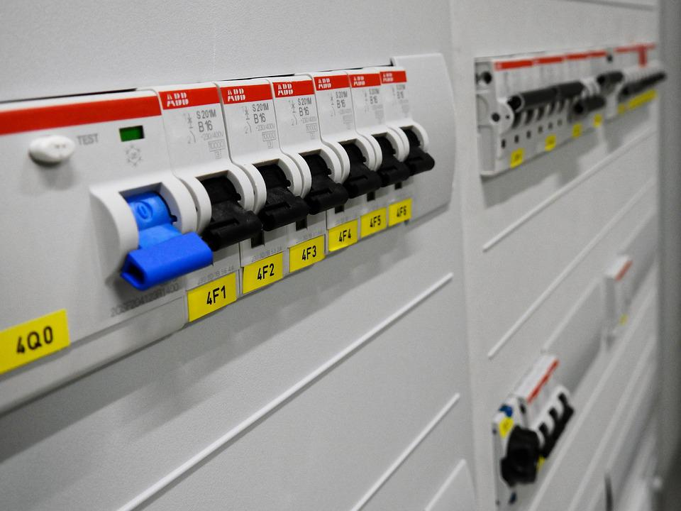
Circuit Breaker
https://docs.microsoft.com/en-us/azure/architecture/patterns/circuit-breaker

Slide 232


Circuit Breaker

Slide 233
Circuit Breaker
Notes:
->

Slide 234
Circuit Breaker
Notes:
->

Slide 235
Circuit Breaker
Notes:
->

Slide 236
Circuit Breaker
Notes:
->

Slide 237
Circuit Breaker
Notes:
->

Slide 238
Circuit Breaker
Notes:
->

Slide 239
Circuit Breaker
Notes:
->

Slide 240
Circuit Breaker
Notes:
->

Slide 241
Circuit Breaker

Slide 242
Circuit Breaker

Slide 243
Circuit Breaker
Notes:
$q.Status = "ReceiveDisabled"
Set-AzServiceBusQueue -ResourceGroup mygrp -NamespaceName myns -QueueName myqueue -QueueObj $q

Slide 244
Circuit Breaker
Notes:
->

Slide 245
Circuit Breaker

Slide 246
Circuit Breaker
Notes:
->

Slide 247
Circuit Breaker
Notes:
->

Slide 248
Circuit Breaker

Slide 249
Circuit Breaker
Notes:
->

Slide 250
Circuit Breaker

Slide 251
Circuit Breaker

Slide 252
Circuit Breaker
Notes:
->

Slide 253
Circuit Breaker
Notes:
->

Slide 254
Circuit Breaker
Notes:
->

Slide 255
Circuit Breaker
Notes:
->

Slide 256
Circuit Breaker
Notes:
->

Slide 257
Circuit Breaker
Notes:
->

Slide 258
Circuit Breaker
Notes:
->

Slide 259
Circuit Breaker
Notes:
->

Slide 260
Circuit Breaker
Notes:
->

Slide 261
Circuit Breaker
Notes:
->

Slide 262
Circuit Breaker
Notes:
->

Slide 263
Circuit Breaker
Notes:
->

Slide 264
Circuit Breaker
Notes:
->

Slide 265
Circuit Breaker
Notes:
->

Slide 266
Circuit Breaker
Notes:
->

Slide 267
Circuit Breaker

Slide 268
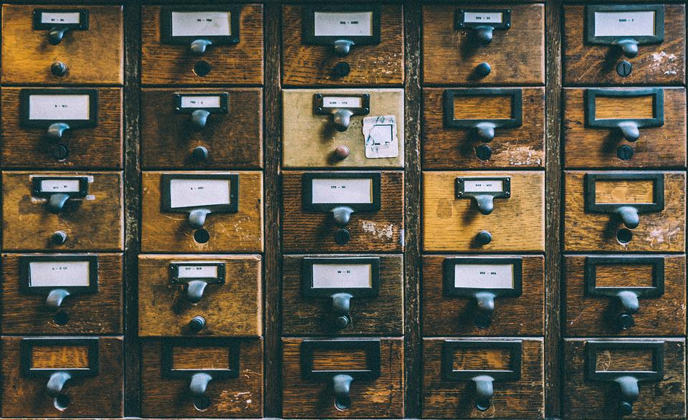
Transactional Outbox
https://docs.microsoft.com/en-us/azure/architecture/best-practices/transactional-outbox-cosmos

Slide 269

Transactional Outbox

Slide 270
Transactional Outbox
Notes:
->

Slide 271
Transactional Outbox

Slide 272
Transactional Outbox
Notes:
->

Slide 273
Transactional Outbox

Slide 274
Transactional Outbox

Slide 275
Transactional Outbox
Notes:
->

Slide 276
Transactional Outbox
Notes:
->

Slide 277
Transactional Outbox
Notes:
->

Slide 278
Transactional Outbox

Slide 279
Transactional Outbox

Slide 280
Transactional Outbox

Slide 281
Transactional Outbox
1

Slide 282
Transactional Outbox
1
2
Notes:
->

Slide 283
Transactional Outbox
2
1
Notes:
->

Slide 284
Transactional Outbox
2
1
Notes:
->

Slide 285
Transactional Outbox
2
1
Notes:
->

Slide 286
Transactional Outbox
2
1
Notes:
->

Slide 287
Transactional Outbox
2
1
Notes:
->

Slide 288
Transactional Outbox
2
Notes:
->

Slide 289
Transactional Outbox
2
Notes:
->

Slide 290
Transactional Outbox

Slide 291
Transactional Outbox

Slide 292
Transactional Outbox
2
Notes:
->

Slide 293
Transactional Outbox
2
Notes:
->

Slide 294
Transactional Outbox
2

Slide 295
Transactional Outbox
2

Slide 296
Transactional Outbox

Slide 297

Saga
https://weblogs.asp.net/sfeldman/sagas-with-azure-service-bus

Slide 298
Saga

Slide 299
Saga
12
Notes:
->

Slide 300
Saga
12
Notes:
->

Slide 301
Saga
12

Slide 302
Saga
34
12
Notes:
->

Slide 303
Saga
12
34
Notes:
->

Slide 304
Saga
12
34

Slide 305
Saga
12
34
34
Notes:
->

Slide 306
Saga
12
34
34
Notes:
->

Slide 307
Saga
12
34
34

Slide 308
Saga
12
34
34
Notes:
->

Slide 309
Saga
12
34
34
Notes:
->

Slide 310
Saga
12
34
34

Slide 311
Saga
12
34
12
34
Notes:
->

Slide 312
Saga
12
12
34
34
Notes:
->

Slide 313
Saga
12
12
34
34

Slide 314
Saga
12
12
34
Notes:
->

Slide 315
Saga
12
12
34
Notes:
->

Slide 316
Saga
12
12

Slide 317
Saga
56
12
12
Notes:
->

Slide 318
Saga
56
12
12
56

Slide 319
Saga
56
12
12
56
Notes:
->

Slide 320
Saga
12
12
56
56
Notes:
->

Slide 321
Saga
12
12
56
56

Slide 322
Saga
12
56
56
Notes:
->

Slide 323
Saga
12
56
56

Slide 324
Saga
78
12
56
56
Notes:
->

Slide 325
Saga
12
78
56
56
Notes:
->

Slide 326
Saga
78
12
56
56

Slide 327
Saga
78
56
56
Notes:
->

Slide 328
Saga
78
56
56
Notes:
->

Slide 329
Saga
78
56
Notes:
->

Slide 330
Saga
78
56
Notes:
->

Slide 331
Saga
78
Notes:
->

Slide 332
Saga
Notes:
->

Slide 333

Saga

Slide 334
Saga

Slide 335
Saga

Slide 336

Almost done…

Slide 337
Key take-aways
Messaging patterns allow to solve recurring challenges
Azure Service Bus offers a variety of features to implement these patterns
Complement with other Azure services

Slide 338




Thank You
@egrootenboer
servicebuspm@microsoft.com
https://www.linkedin.com/in/eldert-grootenboer
https://aka.ms/MessagingFeedbackDWX

Slide 339



Thank you!
@borzenko_lena
olena-borzenko
borzenko.olena
@egrootenboer
eldert-grootenboer
eldert.grootenboer
Notes:
O + E

